Slide 1
MG5596
Strategic Management
Mergers and Acquisitions

Slide 2
Mergers and Acquisitions
Diversification pathways
Related and unrelated diversification
    Organic development
      Mergers and acquisitions
        Strategic alliances….

Slide 3
Related and Unrelated Diversification
Related Diversification
- A process that takes place when a business expands its activities into product lines that are similar to those it currently offers
- Example: Honda Motor Company: best known for its cars and trucks, the company actually started out in the motorcycle and boat motor industries & etc.
Unrelated Diversification
- A process that takes place when a business expands its activities into diverse set of products which have no relation to each other
Example: GE Company: operates through aviation, healthcare, power, renewable energy, digital industry, additive manufacturing, venture capital and finance and lighting

Slide 4
Organic development Vs Mergers & Acquisitions
  DIY diversification:
    corporate entrepreneurship: refers to entrepreneurial activities, such as innovation, venturing, and strategic renewal, within existing firms (Zahra, 1996)
  Business expansion via increased output, customer base expansion, or new product development
  Opposed to mergers and acquisitions, which is inorganic growth
  Example of Organic development: Easy jet → Easy Food-store

Slide 5
Advantage of Organic Development
Knowledge and learning
Spreading investment over time
No availability constraints
Strategic independence

Slide 6
Advantage of Organic Development
Knowledge and learning:
  Using organisation’s existing capabilities to pursue a new strategy
Spreading investment over time
  So there will be a reduction of upfront commitment which it make it easier to reserve or adjust a strategy
No availability constraints
  No need to wait until a perfect acquisition or alliance opportunity comes to the market
Strategic independence
  No need to make same compromises as alliance with partner organisation

Slide 7
Mergers and Acquisitions
An acquisition involves one firm taking over the ownership (equity) of another, hence the alternative term ‘takeover’
    Hostile—Friendly
A merger is the combination of two previously separate organizations to form a new company
    typically as more or less equal partners

Slide 8
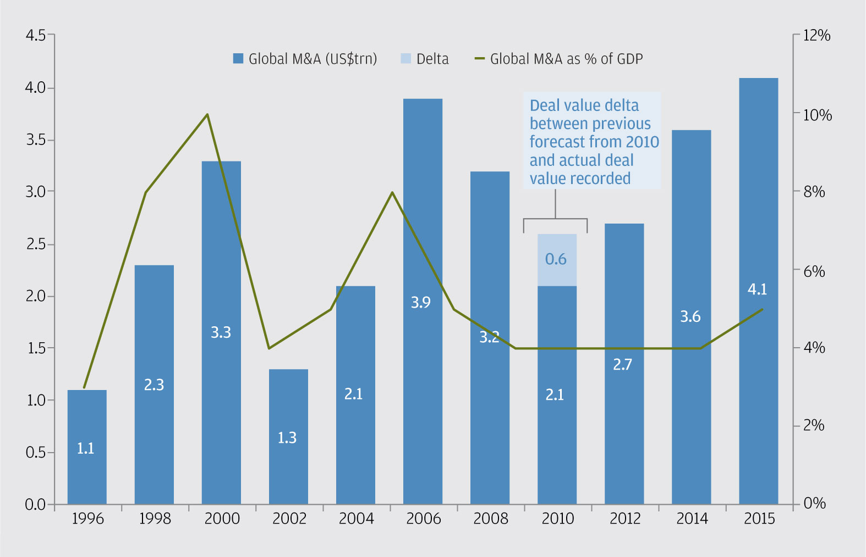
Mergers and Acquisitions
Value of merger and acquisition deals worldwide from 2006 to 2015

Slide 9
Mergers and Acquisitions
Indirect suppliers
Upstream vertical M&A
Direct suppliers
Horizontal competitive M&A
Horizontal complementary M&A
Other indirect competitors
Direct competitors
Core activity
Closely related enterprises
Marginally related enterprises
Direct Customers
Downstream vertical M&A
Indirect Customers

Slide 10
Mergers and Acquisitions
MA can allow enterprises to:
- grow or downsize
- change the nature of their business or competitive position
The key aim of the MA :
- to improve the competitive advantage

Slide 11
Mergers and Acquisitions
motives for M&A:
    Strategic- Financial – Managerial

Slide 12
Motives for M&A
  Strategic Motives:
    Extension in terms of geography, products or markets
    Consolidation:
      Consolidate competitors in the industry to increase:
        market power
        Production efficiency
    Capabilities:
      E.g. Through buying new technologies
Global forces and the Western European Brewing industry

Slide 13
Motives for M&A
  Financial Motives:
    Financial efficiency
      Strong balance sheet (more assets than liabilities): intelligent working capital, positive cash flow, a balanced capital structure, income generating assets
    Tax efficiency
      Tax efficiency refers to structuring an investment so that it receives the least possible taxation
    Asset stripping
      selling off a company's assets in order to improve returns for equity investors, e.g. sale-and-leaseback of a building

Slide 14
Motives for M&A
Managerial Motives:
Personal ambition
  bonus, boost personal reputation, overconfidence
Bandwagon effect
  a psychological phenomenon
  pressure in M&A cycles from analysts and media, shareholders

Slide 15
The M&A processes

Slide 16
Mergers and Acquisitions
The M&A processes
a. Search to identify an acquisition target
  b. Negotiating the right price
    c. Integrate the new and old business together
Target Choice
Strategic fit
  to which extent is it complementing or strengthening the strategy
  Organizational fit
    match between managerial practices, cultural practices and staff characteristics

Slide 17
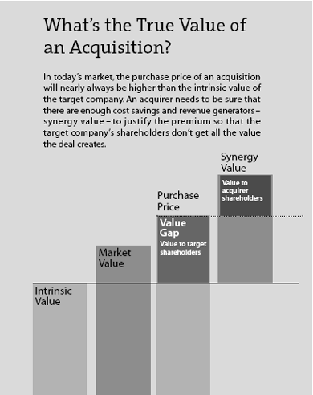
Mergers and Acquisitions
Valuation in M&A
Financial analysis techniques:
  payback period, discounted cash flows,&
  shareholder value analysis
Premium control
  Often a premium for control is paid
Beware of Winners curse and vicious circle of overvaluation
  a tendency for the winning bid in an auction to exceed the true worth of the company

Slide 18
Mergers and Acquisitions
Integration
Two key criteria that a successful integration depend on:
  The extent of strategic interdependence
    Needs to share capabilities
  The need for organizational autonomy
    distinct culture, management style, geographic distance, etc.

Slide 19
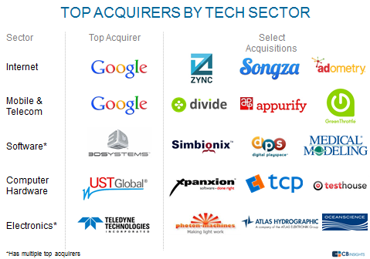
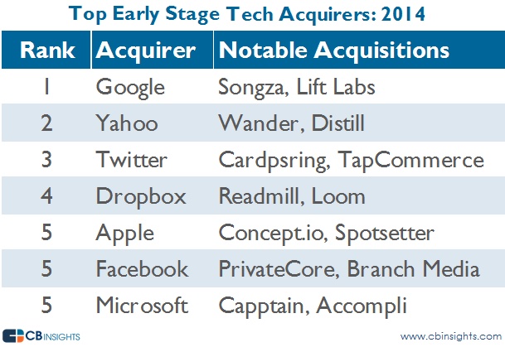
Mergers and Acquisitions
M&A over time:
- Serial acquirers
- Divesture

Slide 20
Why so many acquisitions performance disappoint

Slide 21
Mergers and Acquisitions
Why so many acquisitions performance disappoint
-When strategic logic of integration is weak
    -Financial logic was poor or compromised
      -Inadequate ‘due diligence’

Slide 22
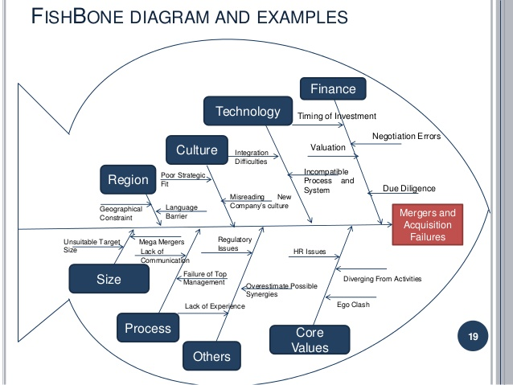
Mergers and Acquisitions

Slide 23
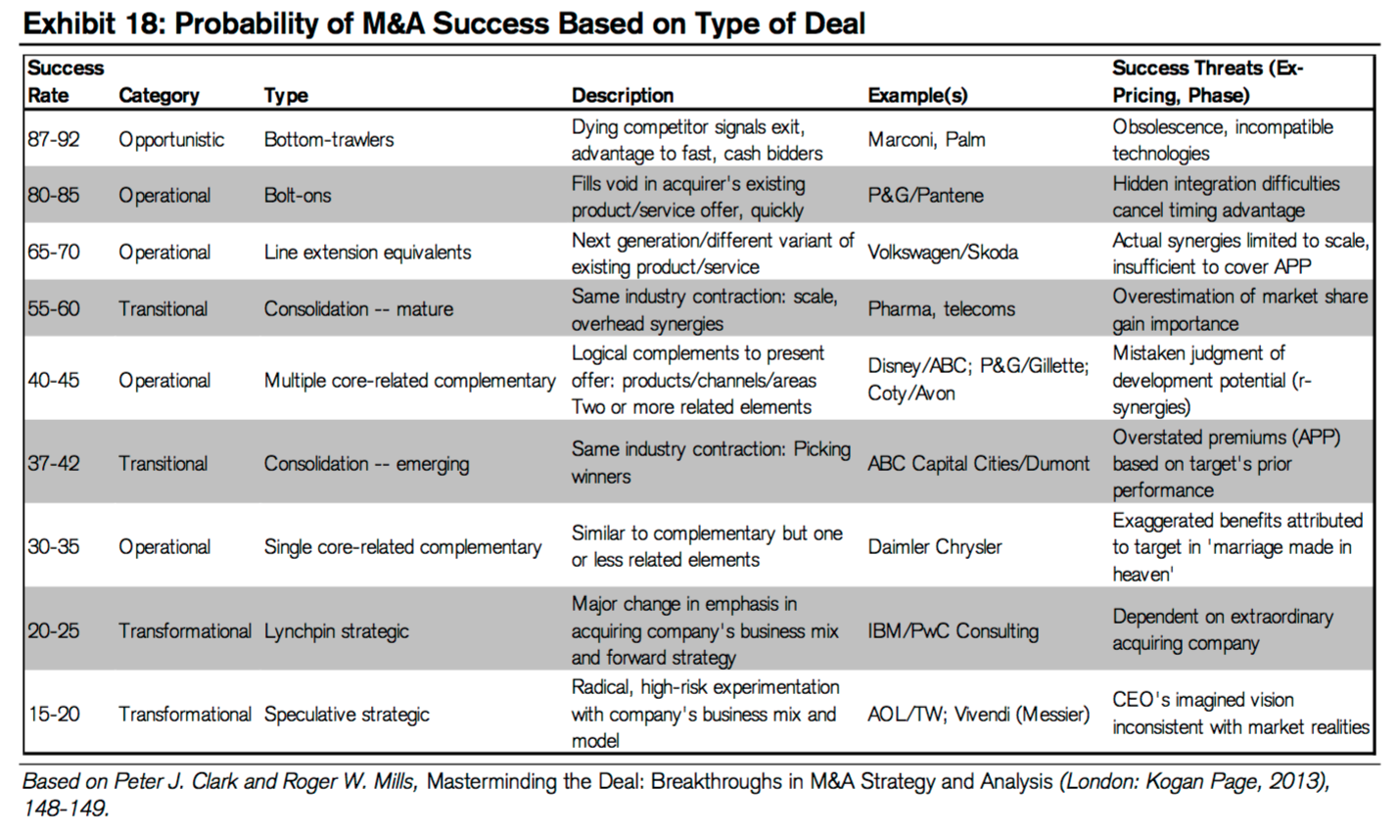
Mergers and Acquisitions

Slide 24
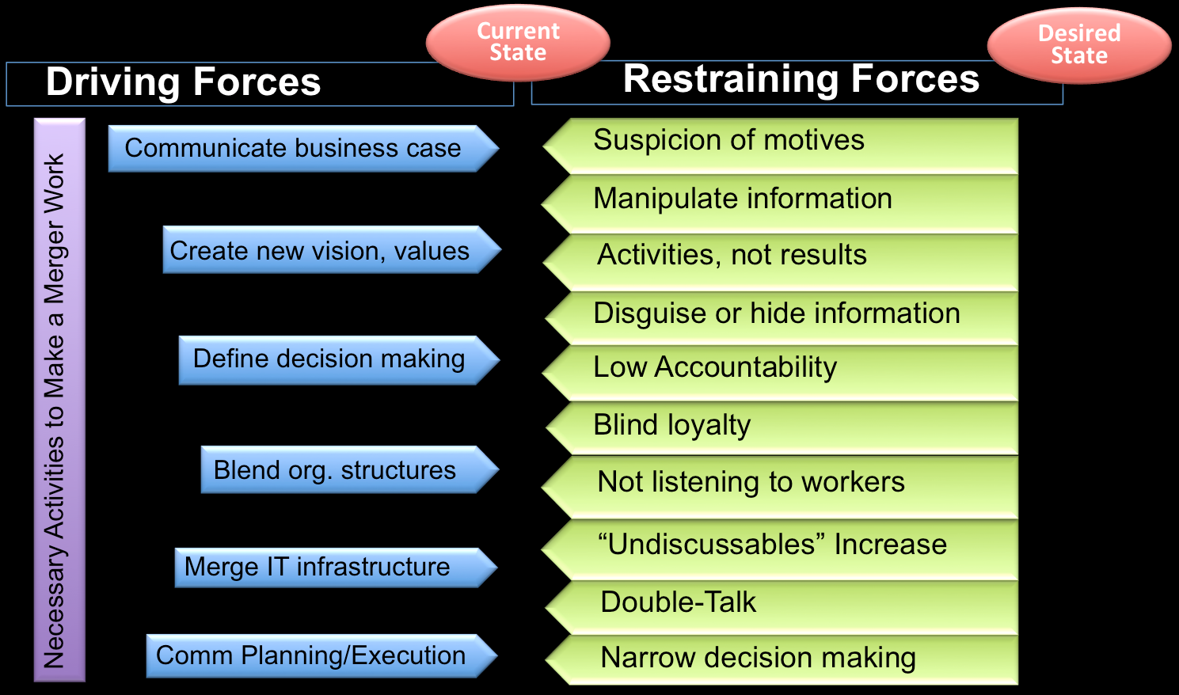
Mergers and Acquisitions

Slide 25
Mergers and Acquisitions
References
Goel, A. M., & Thakor, A. V. (2010). Do envious CEOs cause merger waves? Review of Financial Studies, 23(2), 487-517.
Haspeslagh, P. C., & Jemison, D. B. (1991). Managing acquisitions: Creating value through corporate renewal (Vol. 416). New York: Free Press.
Johnson, G., Scholes, K., & Whittington, R. (2010). Exploring corporate strategy: text & cases. Pearson Education.
Porter, M.A (1987) From Competitive Advantage to Corporate Strategy, Harvard Business Review, May-June, 43-59.
Pitt, M. R., & Koufopoulos, D. (2012). Essentials of strategic management. Sage.

